Slide 1

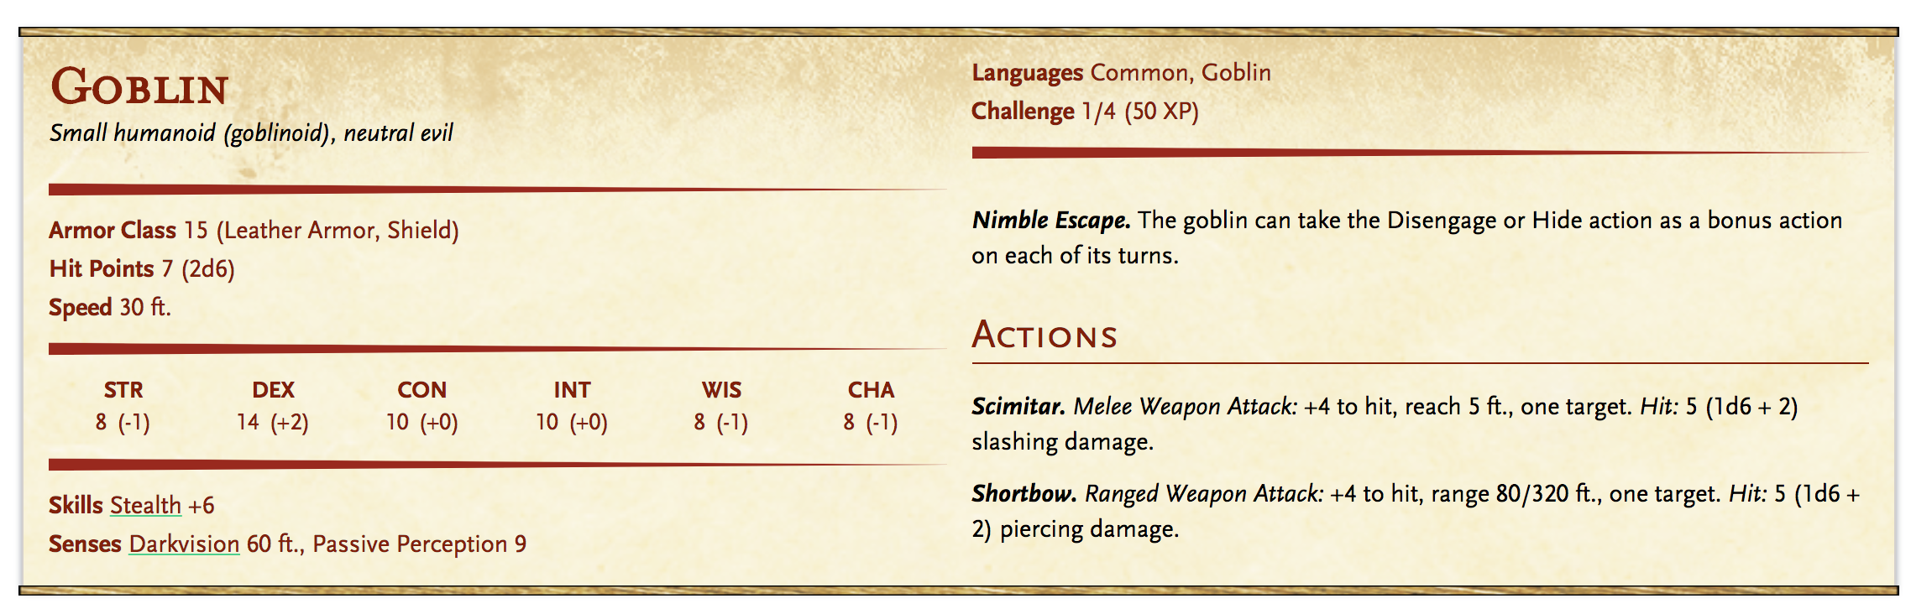
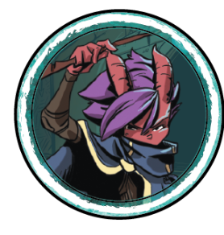
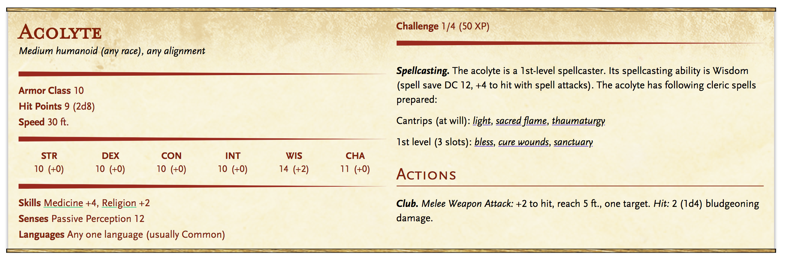
The Challenges of Being a Narrator (The Scope of DM Tools)
Things the narrator keeps track of:
Where are the characters?
How healthy are the characters?
What can/would each of the characters do?
How can each of the characters do this?
What does the character have with them and why?
And more...
Notes:
Each character, like the two we have on the left, has a lot of information associated with them, like we see in the middle. Of course, this information only exponentially grows as we increase the number of characters in a story, and as we know in any good adventure story, there’s rarely just a handful of characters. The narrator, as they build the world around the players, has to manage all of this information, which results in a flurry of page turning as they struggle to keep on top of keeping the story moving. All the while, they have to answer the following questions in the back of their mind [read of questions]. Which is where we’d like our product at its minimum viable product state to aid the narrators.

Slide 2



Our Vision
- Viewing one character’s details at a time - Limited interaction with characters’ information - Managing story details by yourself - Generic for all tabletop games - Manual data entry and managing details of the game - Focused on replacing the in-person experience with a virtual one - Augmenting and complimenting the personal experience of in-person D&D - Providing a centralized means of organizing and generating details for gameplay
Notes:
Dndbeyond you can only see one monster/character’s details at a time, so now you just flip between tabs, and you still ahve to manage story details yourself
Roll20 generic for all table tops so still manual entering of data and focused on virtual gameplay. It has maps/voice/etc, so it focuses on replacing the in person experience
We don’t want to replace the personal experience of a tabletop, but augment and compliment by providing a centralised means of organizing and generating details about your story and gameplay.

Slide 3



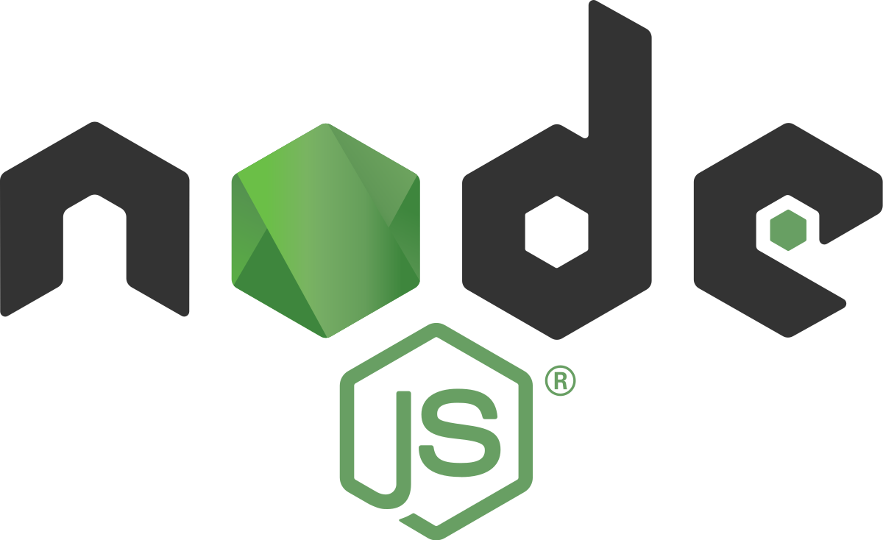

Our MVP (& Framework Stack)
Viewing multiple characters’ information at the same time
Assisted crafting of a story and tracking aspects around combat sequences
Partially automated generation and management of character statuses
Save and load combat sequences
Electron Node JS Jest Enzyme Postgres SQL

